Slide 1


Esri GeoDev Webinar Series
Using TypeScript with the ArcGIS API for JavaScript
Notes:
September’s GeoDev Webinar, "Using TypeScript with the ArcGIS API for JavaScript”, with Rene Rubalcava and Noah Sager.
https://www.esri.com/en-us/landing-page/product/2018/geodev-webinar-series/using-typescript-with-the-arcgis-api-for-javascript

Slide 2
Esri GeoDev Webinar Series
Using TypeScript with the ArcGIS API for JavaScript
Rene Rubalcava
Noah Sager
September 26, 2018
Notes:
September’s GeoDev Webinar, "Using TypeScript with the ArcGIS API for JavaScript”, with Rene Rubalcava and Noah Sager.
https://www.esri.com/en-us/landing-page/product/2018/geodev-webinar-series/using-typescript-with-the-arcgis-api-for-javascript

Slide 3
Agenda
ArcGIS API for JavaScript 4.x
TypeScript
Converting a JavaScript app to TypeScript
Development Resources
Custom Widgets
Notes:
There is no hidden agenda.

Slide 4



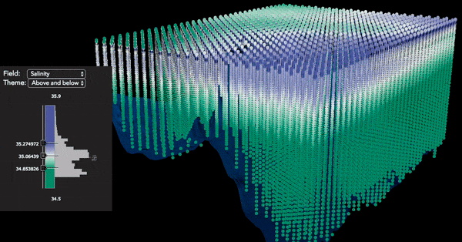


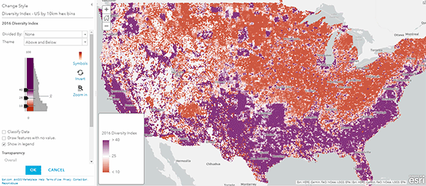
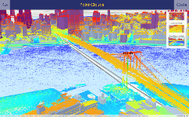

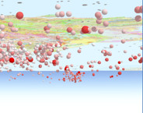
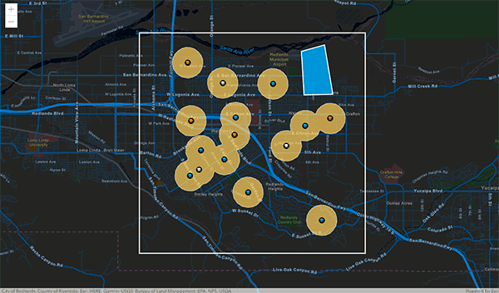
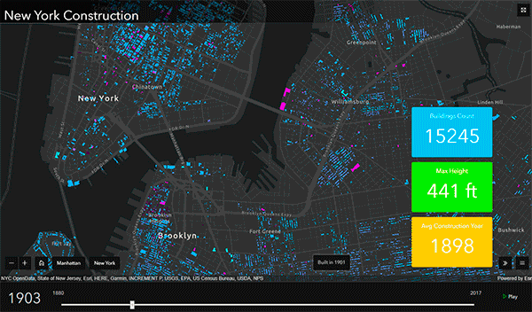



ArcGIS API for JavaScript | Enabling Powerful and Modern Web GIS Apps
Directions
3D Scenes
3D Measurement
Data-Driven Visualization
Widgets and Tools
Smart Mapping
Drawing Tools
Client-Side Mapping
and Processing
Client-Side Projection
Real-Time Geometric Analytics
3D Mobile Web
Fast Interaction with Large Datasets
Fast Display of Large Datasets
Interactive Analysis
Notes:
Quick intro to the ArcGIS API for JavaScript. In the last year, this API has grown with new client-side processing capabilities such as a projection engine, and the ability to query and summarize data on the client. It uses modern browser technology to enable powerful workflows with optimized performance to display large quantities of data in the view with dynamically updated visualization. This is going to open up broadly the use of GIS across society.

Slide 5

ArcGIS API for JavaScript - 4.9 (coming soon)
Notes:
Quick intro to the SDK for the ArcGIS API for JavaScript – 4.9
https://developers.arcgis.com/javascript/latest/guide/index.html

Slide 6
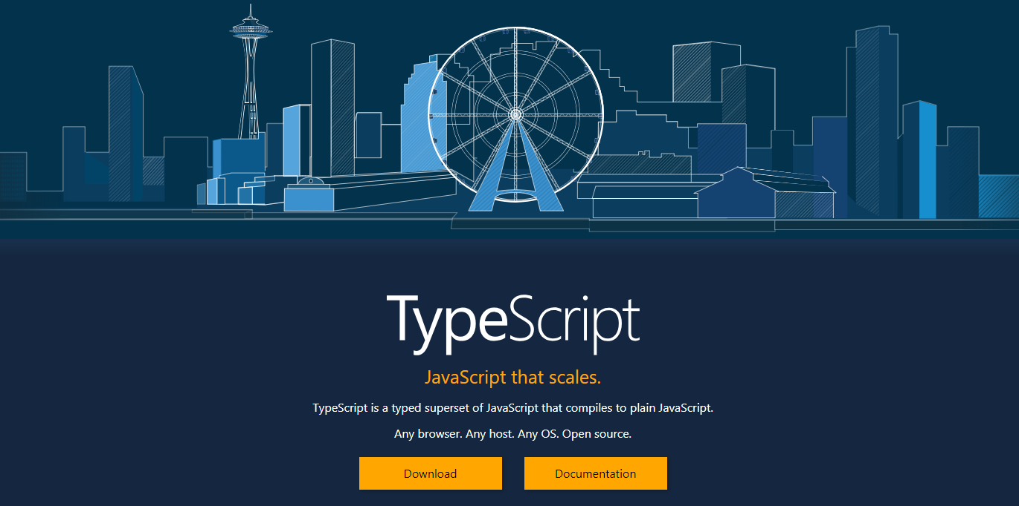
What is TypeScript?
Notes:
TypeScript is an open-source programming language developed and maintained by Microsoft. It is a strict syntactical superset of JavaScript, and adds optional static typing to the language.
TypeScript is designed for development of large applications and transcompiles to JavaScript. As TypeScript is a superset of JavaScript, existing JavaScript programs are also valid TypeScript programs. TypeScript may be used to develop JavaScript applications for both client-side and server-side (Node.js) execution.
TypeScript supports definition files that can contain type information of existing JavaScript libraries, much like C++ header files can describe the structure of existing object files. This enables other programs to use the values defined in the files as if they were statically typed TypeScript entities. There are third-party header files for popular libraries such as jQuery, MongoDB, and D3.js. TypeScript headers for the Node.js basic modules are also available, allowing development of Node.js programs within TypeScript.

Slide 7
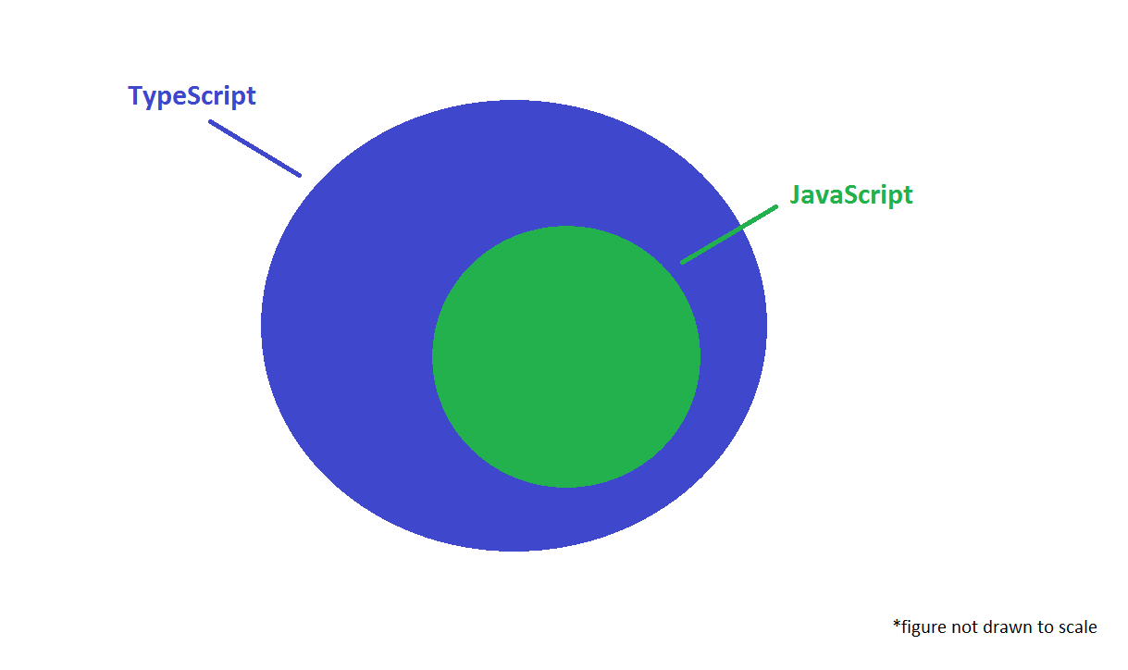
TypeScript is a superset of JavaScript
Notes:
TypeScript has a unique philosophy compared to other languages that compile to JavaScript. JavaScript code is valid TypeScript code; TypeScript is a superset of JavaScript.
You can almost rename your .js files to .ts files and start using TypeScript.
TypeScript files are compiled to readable JavaScript, so that migration back is possible and understanding the compiled TypeScript is not hard at all.
TypeScript builds on the successes of JavaScript while improving on its weaknesses.
Image links to StackOverflow discussion: https://stackoverflow.com/questions/12694530/what-is-typescript-and-why-would-i-use-it-in-place-of-javascript/35048303#35048303

Slide 8
Why TypeScript?
TypeScript adds type support to JavaScript
Notes:
TypeScript adds type support to JavaScript
Enhanced IDE support
Makes use of the latest JavaScript features

Slide 9
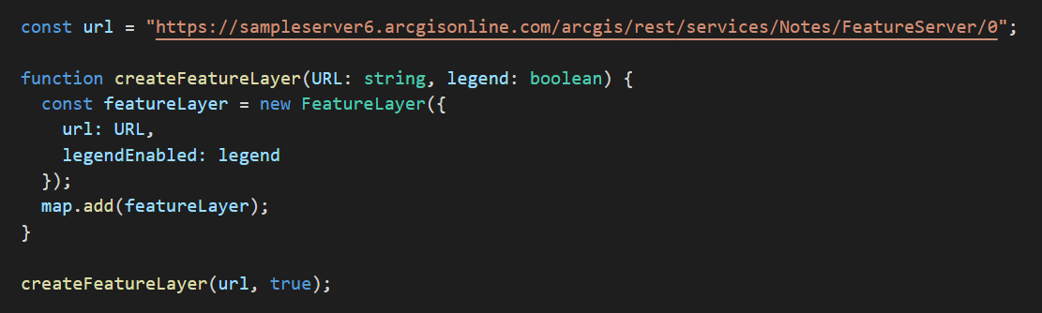
Why TypeScript?
Notes:
Function takes two parameters. One of type `string` and one of type `boolean`.

Slide 10
Why TypeScript?
TypeScript adds type support to JavaScript
Enhanced IDE support
Notes:
TypeScript adds type support to JavaScript
Enhanced IDE support
Makes use of the latest JavaScript features

Slide 11
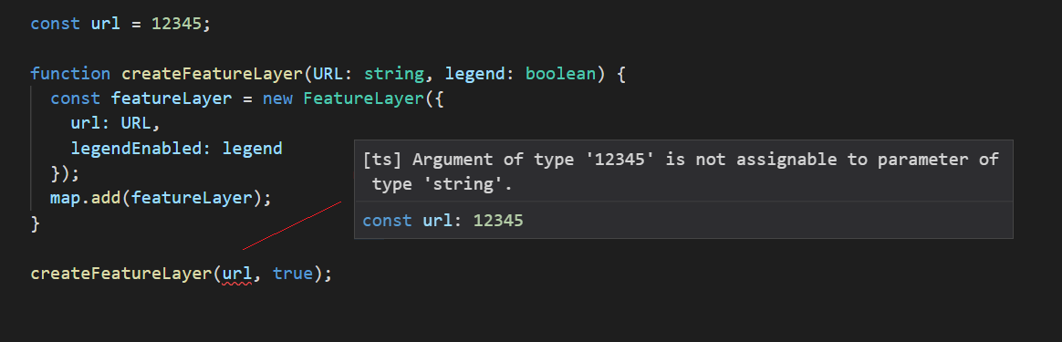
Why TypeScript?
Notes:
Error. Visual Studio Code shows error message in compiler.
We tried to pass a variable of type `integer` to a function that expected a variable of type `string`.

Slide 12
Why TypeScript?
TypeScript adds type support to JavaScript
Enhanced IDE support
Makes use of the latest JavaScript features
Notes:
TypeScript adds type support to JavaScript
Enhanced IDE support
Makes use of the latest JavaScript features

Slide 13
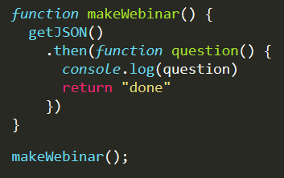
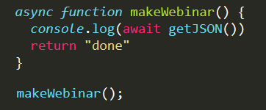
Why TypeScript? Latest JavaScript Features
promises
async / await
Notes:
Async/await
Dynamic imports
Es5/es6/es7/es8

Slide 14
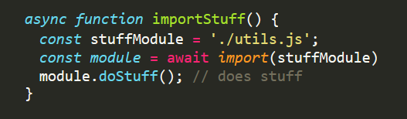
Why TypeScript? Latest JavaScript Features
Dynamic imports
compute the module at runtime
import a module on-demand (or conditionally)
import a module from within a regular script (as opposed to a module)
Notes:
Async/await
Dynamic imports
Es5/es6/es7/es8

Slide 15
Convert JS App to TS
JavaScript to TypeScript
Since TypeScript is a superset of JavaScript …
Conversion can be done in steps

Slide 16
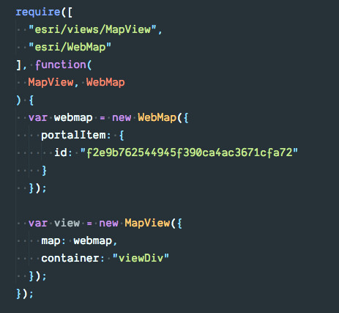
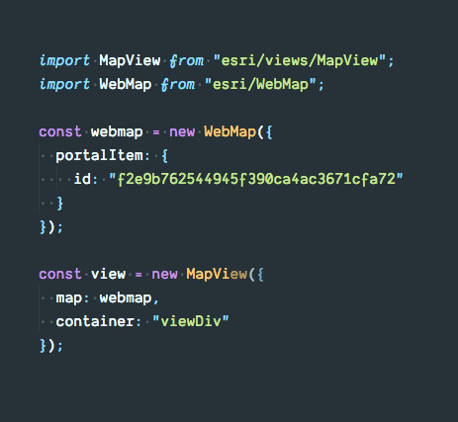
Convert JS App to TS

Slide 17
Convert JS App to TS
Step 1
Do not need require statements.
Use import statements instead.

Slide 18
Convert JS App to TS
Step 2
Replace var with const or let.
Define Types and/or Interfaces

Slide 19
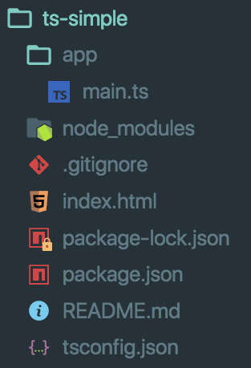
TypeScript
Basic Application Structure

Slide 20
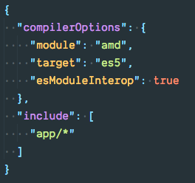
TypeScript – tsconfig.json
Bare minimum configuration
Output files as AMD modules

Slide 21
TypeScript – tsconfig.json
Bare minimum configuration
Output JavaScript as ES5

Slide 22
TypeScript – tsconfig.json
Bare minimum configuration
Use
Instead of

Slide 23
TypeScript – tsconfig.json
Bare minimum configuration
Where are my TypeScript files?

Slide 24
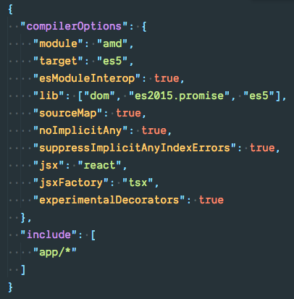
TypeScript – tsconfig.json
Optional Configuration
Needed for async/await

Slide 25
TypeScript – tsconfig.json
Optional Configuration
Output sourcemaps for debugging

Slide 26
TypeScript – tsconfig.json
Optional Configuration
You can use any type, but must declare it

Slide 27
TypeScript – tsconfig.json
Optional Configuration
Suppress the noImplicityAny errors for indexing objects

Slide 28
TypeScript – tsconfig.json
Optional Configuration
Used for custom widget development

Slide 29
TypeScript Features
Types and Interfaces
Type Guards
Dynamic Imports

Slide 30
TypeScript
Simple Example

Slide 31
TypeScript
More Involved Example

Slide 32
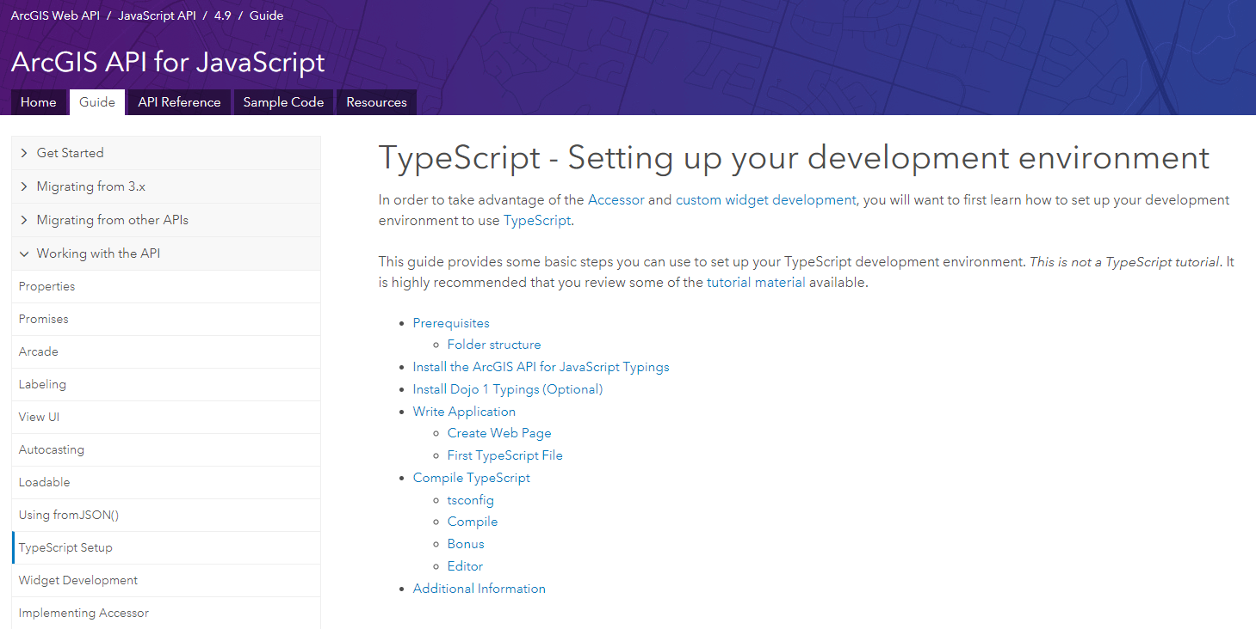
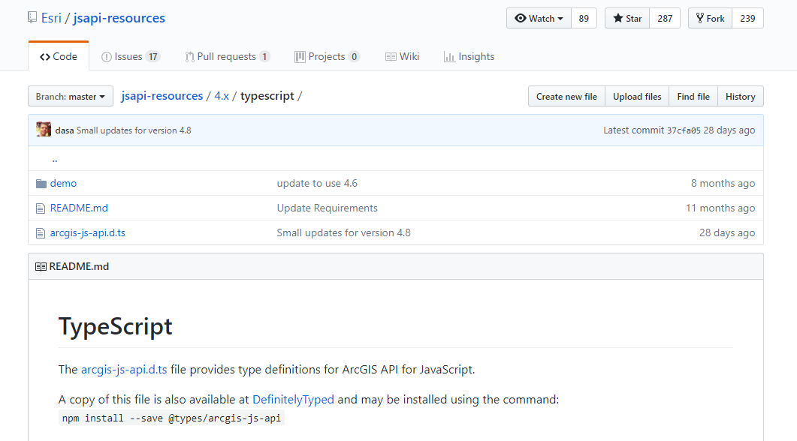


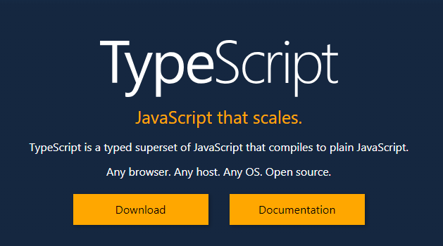


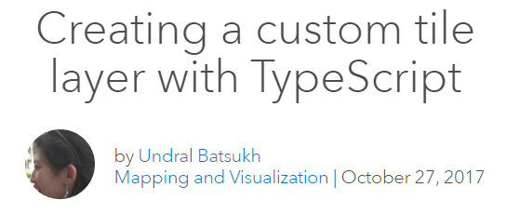
Resources
Notes:
Resources for JS API + TypeScript (each image hyperlinks to the appropriate online resource).
+webpack demo one
+cli blog
Api-resources can be updated day-of
Takes a couples of days to npm install typings
+
https://developers.arcgis.com/javascript/latest/guide/custom-widget/index.html
https://developers.arcgis.com/javascript/latest/guide/implementing-accessor/index.html

Slide 33
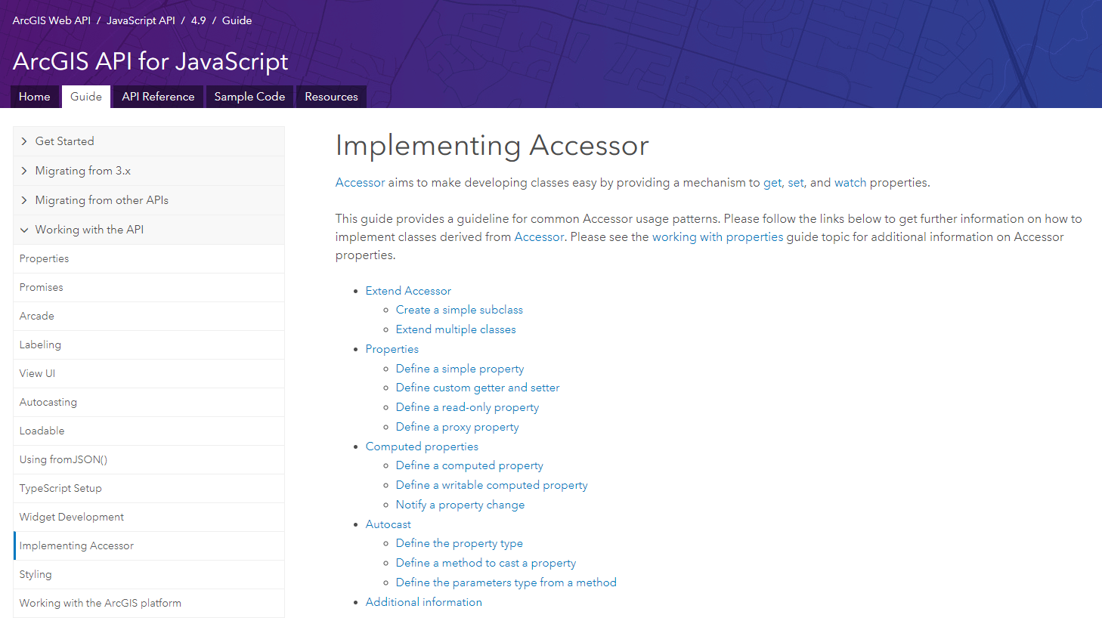
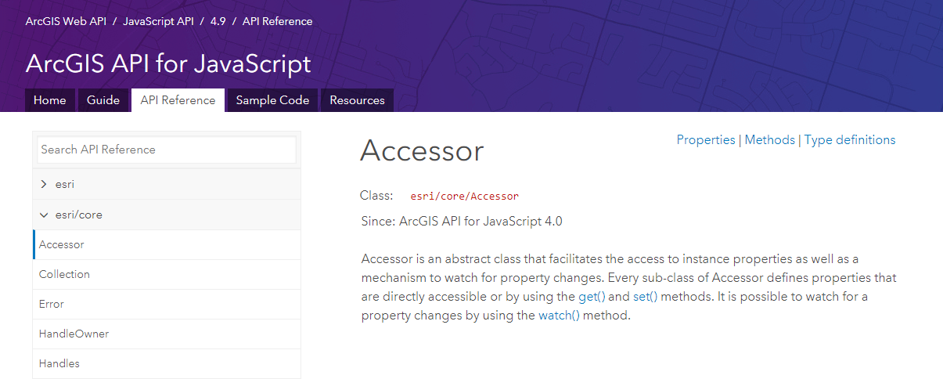
Implementing Accessor - esri/core/Accessor class
Notes:
Accessor aims to make developing classes easy by providing a mechanism to get, set, and watch properties.
Accessor is an abstract class that facilitates the access to instance properties as well as a mechanism to watch for property changes. Every sub-class of Accessor defines properties that are directly accessible or by using the get() and set() methods. It is possible to watch for a property changes by using the watch() method.
https://developers.arcgis.com/javascript/latest/guide/implementing-accessor/index.html

Slide 34
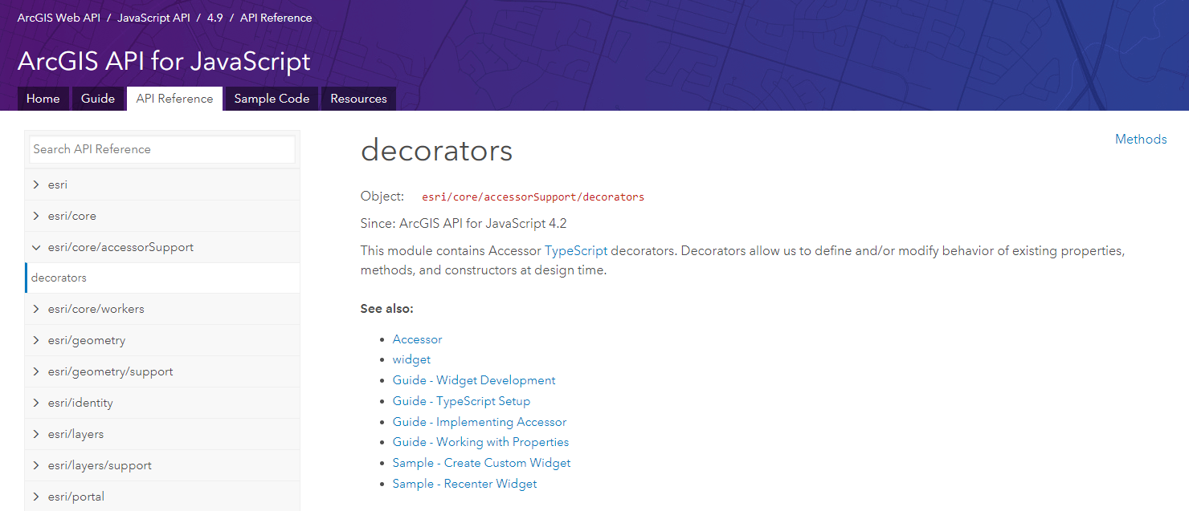
esri/core/accessorSupport/decorators module
Notes:
This module contains Accessor TypeScript decorators. Decorators allow us to define and/or modify behavior of existing properties, methods, and constructors at design time.
https://developers.arcgis.com/javascript/latest/api-reference/esri-core-accessorSupport-decorators.html

Slide 35
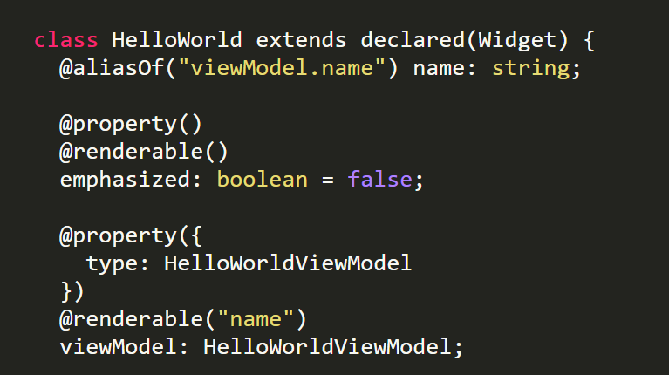
esri/core/accessorSupport/decorators – aliasOf()
Notes:
A property decorator that creates a two-way binding between the property it decorates and an inner property of one of its members.
https://developers.arcgis.com/javascript/latest/api-reference/esri-core-accessorSupport-decorators.html#aliasOf

Slide 36
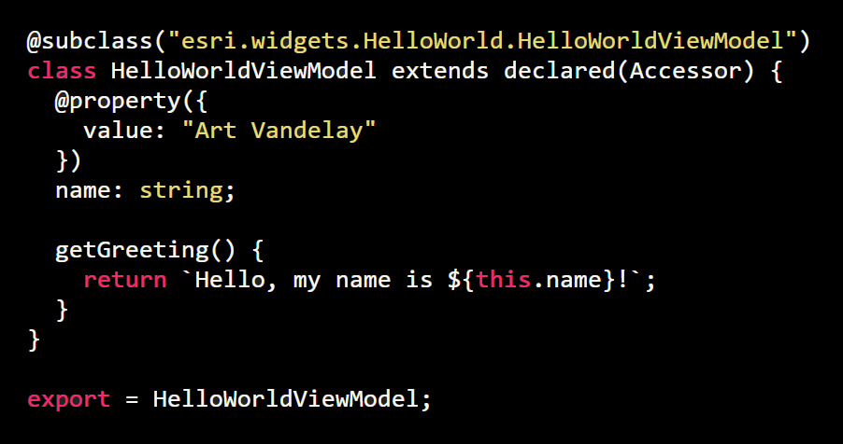
esri/core/accessorSupport/decorators – property()
Notes:
This convenience decorator is used to define an Accessor property. Any property defined with this decorator can now be get and set.
In addition, you can watch for any property changes. Many times this decorator is used in conjunction with the @renderable decorator.
https://developers.arcgis.com/javascript/latest/api-reference/esri-core-accessorSupport-decorators.html#property

Slide 37
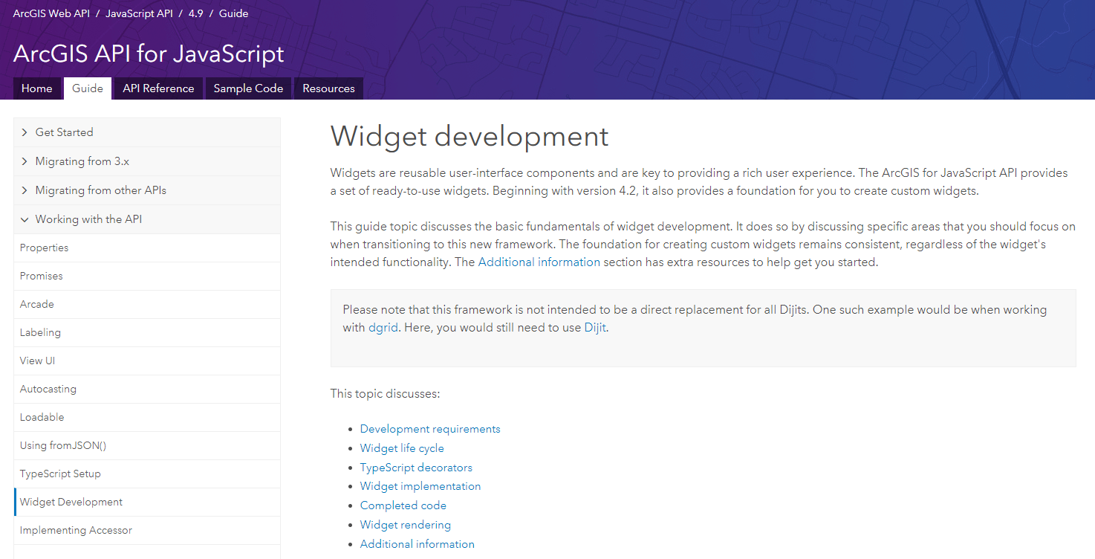
Widget development
Notes:
https://developers.arcgis.com/javascript/latest/guide/custom-widget/index.html

Slide 38
TypeScript Example
Custom Widget Example

Slide 39
TypeScript Example
We can help make it easier for you!
npm install @arcgis/cli

Slide 40

“It is not the strongest of the species that survive,
Nor the most intelligent,
But the ones most responsive to change.”
— Charles Darwin
Notes:
We want to close with this quote attributed to Charles Darwin. "It's not the strongest of species that survive, nor the most intelligent, but the ones that are most responsive to change."

Slide 41

© 2018 Esri. All rights reserved.
Notes:
The science of where it’s at.

